Slide 1
Your Medicare partner
Welcome PEIP retirees
Notes:
Hi and Welcome everyone to the HealthPartners presentation of the Medicare retiree plan options for 2023 offered through PEIP.
Today we will review the 2023 HP Journey Medicare Advantage plan updates and features and let you know if you there is anything you should do for 2023.

Slide 2
Our CMS Star Rating is a 5 out of 5 for 2022!
We're a top-rated health plan.
Here are some reasons why
We help people get healthy and stay healthy with preventive care.
We're there when you need us - for the little things and the big things - with advice, treatment and support.
Our members get outstanding service from our team of experts.
Every year, Medicare evaluates plans based on a 5-Star rating system. The overall Star Rating for HealthPartners® Journey (PPO) is 5 out of 5 stars for plan year 2022.
Notes:
Each year, CMS measures how well Medicare health plans perform. The scale that's used is known as the Star Rating System. Ratings range from one to five stars, with five being the highest score a plan can get.
For 2022, we’re proud to say HealthPartners Journey (PPO) received the highest possible rating from CMS.
We earned FIVE STARS because:
We help people get healthy and stay healthy by supporting and driving preventive care initiatives for members.
We’re there when you need us — for little things and the big things — with advice, treatment and support.
Our members consistently receive outstanding service from our team of experts.
Star Ratings are reviewed each year by Medicare. To view ratings, visit www.medicare.gov

Slide 3
Journey (MA) Service Area Expansion
For 2023 10 Minnesota RNC counties convert to Journey (MA) counties
2023 Journey Group Service Area
Aitkin Anoka Becker Beltrami Benton Big Stone Carlton Carver Cass Chippewa Chisago Clay Clearwater Cottonwood | Cook Crow Wing Dakota Douglas Grant Hennepin Hubbard Isanti Itasca Jackson Kanabec Kandiyohi Kittson Koochiching | Lac qui Parle Lake Lake of the Woods LeSueur Lincoln Lyon Mahnomen Marshall McLeod Meeker Mille Lacs Morrison Murray Nobles | Norman Otter Tail Pennington Pipestone Pine Polk Pope Ramsey Red Lake Redwood Renville Rice Rock Roseau | Scott Sherburne Sibley St. Louis Stearns Stevens Swift Todd Traverse Wadena Washington Wilkin Wright Yellow Medicine
Journey MA Counties
Notes:
In 2023 We will provide the Journey Group Plan in 70 counties –increasing service area by 10 additional counties

Slide 4
HealthPartners Journey (MA) plan for retirees
About the Sanford plan
Coverage type
Includes Medical and Part D (prescriptions)
Predictability
Set copays for most medical services and prescription drugs
Budget-friendly
Annual medical out-of-pocket limits, no deductible and protection for prescription drug costs
Network
For in-network medical services you can see any provider that is part of the Journey (MA) group network; includes all major clinic systems in the Twin Cities and Metro
Plan benefits
Hearing aids, preventive care, travel coverage, fitness benefit, discount programs

Slide 5
PEIP Journey (MA) Medical Benefits
Medical Benefits | Plan 1 | Plan 2
Monthly premium | $242.75 | $265.45
Medical Deductible | $0 | $0
Annual out-of-pocket maximum | $3,500 (medical only) $5,000 (combined in & out of network) | $4,500 (medical only) $6,000 (combined in & out of network)
Out of network cost sharing | 40% coinsurance | 40% coinsurance
Routine exams | Preventive care | $0 | $0
Primary clinic visit | $0 | $0
Outpatient hospital | $200 copay | $200 copay (2022: $300)
Inpatient hospital | $200 copay (2022: $400) | $200 copay (2022: $500)
ER | $75 copay | $90 copay
Specialty/Urgent care | $35 copay | $35 copay
Diagnostic radiology | $100 copay (2022: 10%) | $100 copay (2022: 20%)
Virtuwell | Unlimited, $0 member cost
Notes:
PEIP offers 2 plan designs, so you can decide which option is best for you.
For 2023 the benefits on these plans are updated
The plans continue to have routine exams, cancer screenings and preventive care covered at 100%.
You will see here cost sharing amounts are dependent on which plan you choose.
For more details on cost sharing please reach out to Innovo Benefits –contact information highlighted at the end of this presentation.

Slide 6
PEIP Journey (MA) Part D Benefits
Prescription Drug (Part D) | Plan 1 | Plan 2
Deductible | $300 | $0
Tier 1: Preferred generic | $4 copay | $6 copay
Tier 2: Generic | $10 copay | $12 copay
Tier 3: Preferred brand | $47 copay | $47 copay
Tier 4: Non-preferred drugs | 50% coinsurance | 25% coinsurance
Tier 5: Specialty | 27% coinsurance | 25% coinsurance
Coverage gap | 25% coinsurance | Same as above
Catastrophic coverage | Generics: 5% or $4.15 Brands: 5% or $10.35 (whichever is greater)
Preferred cost-sharing mail-order: Get a three-month supply for just two copays!
6

Slide 7
Personal support
Member Services
CareLineSM Service
Nurse NavigatorSM Program
Behavioral Health Navigators
Questions about plan benefits, account balance
Find out if you should see a doctor
Questions about your health care and benefits
Find a mental or chemical health professional in network
Find a doctor in network
Ask questions about your medications
Help choosing a treatment option
Learn about home treatment options
Notes:
As a HealthPartners member, you have access to our 5-star Member Services team for help with: benefits and coverage questions, finding a provider or checking if a medicine is covered or not.
Also, CareLine is available for questions regarding minor illnesses, determining if you should see a doctor or learning about home treatment options.
The Nurse Navigator programs can help with more complex matters like choosing a treatment option or finding a health professional in our behavioral health network.

Slide 8
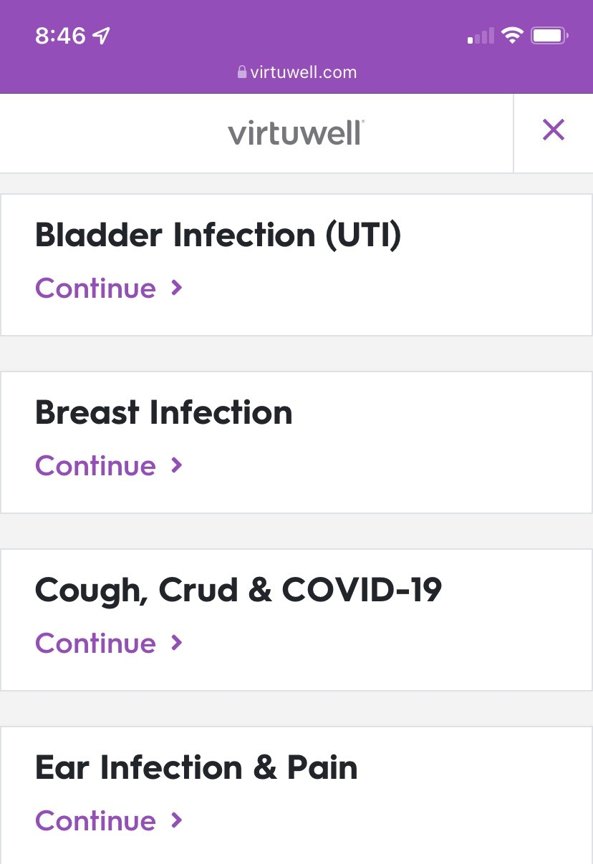
Virtuwell ​
Easy, fast and free
Answer a few questions anytime, anywhere.*
Treatment plan and prescription from a nurse practitioner in about one hour.
More than 60 common conditions.
Your medical plan pays for your visits and treatment. Plus, follow-up calls about your treatment are free.
Notes:
Virtuwell is available to you at no cost. You don't have to leave your home to get care. It is available through your smartphone, tablet, or computer by simply going to virtuwell.com. Keep in mind if you are prescribed a medication when accessing care through virtuwell, the prescription can be sent directly to your pharmacy –now that’s efficient when you are not feeling your best.

Slide 9
SilverSneakers®
SilverSneakers® gives you FREE access to:
Gym membership access to 16,000+ fitness locations nationwide
Stream live online classes or use on-demand workout videos from the comfort of your home
Learn more at
silversneakers.com
Join a SilverSneakers FLEX® class at a nearby park or community center
Notes:
Reach your health and fitness goals with the SilverSneakers fitness program
With SilverSneakers, you’ll get a gym membership with access to 16,000+ fitness locations nationwide. You can be enrolled at multiple gyms at one time. Don't like the gym? Stream live online classes or use on-demand workout videos from the comfort of your home. Or, if you’re looking for something different, join a SilverSneakers FLEX® class at a nearby park or community center. All this at no additional cost.
-------------------------------------------
SilverSneakers is your fitness partner, available at no cost for a basic membership. With nationwide access to over 16,000 facilities in the network -you can now simultaneously join multiple gyms. So attend your favorite yoga class at one facility and go to another for tennis. Fitness benefits have been expanded to include online classroom, coaching, and other services too.

Slide 10
Hearing aids
Quick, simple process:
Members call TruHearing directly
​HealthPartners dedicated phone number​
TruHearing Consultant will answer questions and explain benefits​
If member is ready to set an appointment, consultant will:​
​Find closest provider​
Schedule appointment via 3-way call​
$499, $699 or $999 copay per hearing aid, two per year
Copayment is based on technology level
Appointment/Hearing Aids​
​Member receives audiogram and discusses hearing aid options​
Member places order and makes copayment for aids at provider’s office​
Nationwide service area with over 7,000 providers
Hearing aids arrive in 2-7 days ​
Notes:
The hearing aid benefit continues with our partner: TruHearing
Which color or special features in a hearing aid that you decide best for you -would determine your copay amount
******$499 $699 or $999 ********
There is a network of providers for this benefit and a TruHearing Consultant can help you find the provider convenient to you.
With TruHearing you can count on a professional exam, unlimited follow-up visits, a risk-free trial period and 3-yr manufacture's warranty –just to name a few of the services included.
TruHearing’s website at www.truhearing.com

Slide 11
Travel coverage
Domestic travel
International travel
Assist America*
Travel anywhere in the U.S. and U.S. Territories. You can see any provider that is eligible to participate in Medicare and willing to see you
World wide coverage for emergency and urgent care world-wide
Worldwide emergency travel logistics
Experienced clinicians help with:
Assessing your need for medical care
Coordinating post-stabilization transportation to the nearest medical facility or your home
Interpreter services if in foreign country
And more!
Notes:
All our members have the freedom to travel.
Nationwide You’ll get the same benefit level as if you were in the network at a Medicare eligible provider.
If you are traveling internationally you have emergency and urgently needed coverage.
Assist America is a HP exclusive service included at no cost to help replace lost medications, locate providers for emergencies or if you have unexpectedly fallen ill and need an interpreter when traveling in an unfamiliar area. Please check out assistamerica.com to see the many services included under this benefit -ONLY provided by the HP Medicare plans

Slide 12
Healthy DiscountsSM program
Retail and Service Discounts with member ID card on:
Eyewear
Exercise equipment
Fresh produce and meals
Pet insurance
healthpartners.com/healthydiscounts
And more
Notes:
As a HealthPartners member, you get access to big savings. There are discounts for retailers and services that will help you feel better and achieve the health you want
Eyewear and vision services
Exercise equipment
Healthy eating programs and delivery services
Pet insurance
Swim lessons
Spa Services
And more

Slide 13
Enrolling with HealthPartners Medicare
You can switch to
HealthPartners group plan
or
New to Medicare?
Call Innovo Benefits for guidance
952-746-3101 or 800-829-5601
Return completed enrollment form to Innovo Benefits
Watch for your new member packet to come in the mail

Slide 14
New to retiree group?
Apply for Medicare Part A & B
Here to help.
Call Innovo with questions
Call Innovo Benefits
with any questions along the way.
Complete application
Watch for new member packet

Slide 15
What to expect
Current Members
You have guaranteed plan renewal for 2023
You will receive the Annual Notice of Change
letter in the mail
No new ID cards
Do you need to create your online myHealthPartners account?
NOW YOU CAN
Sit Back. Relax. Know you are covered.

